Slide 1




Presented by :
Yasmin Zacarias
Global Programming Language Analysis
Trends &
Market
Insights

Slide 2

Dataset Overview
Descriptive and comparative analysis with trend and relationship exploration.
01
02
03
29
Python
Rust
Language analyzed
Highest demand (score 51.13)
Highest paying (~$158K)
04
05
06
$123K
22.69
High
Average salary, all languages
Average demand score
Python = only "High Opportunity"
  Demand score ranges from 51.13 (Python) down to 12.89 (Lua)
  Average salary by language ranges from ~$96K to ~$158K

Slide 3


Methodology.
01. Defining Problem & Objective
02. Exploratory
Data Analysis
03. Data
Cleaning
04. Data Analysis
& Visualization
05. Insight & Recommendation
Background,
problem statement,
and objective
Check what is in the data using Python: its structure, columns and values
Clean and prepare the data in Power Query before building the dashboards
Analyze patterns and trends in Power BI dashboards
Address insights and recommend the best languages to learn

Slide 4


Problem Statement
With 29 programming languages to choose from, career changers entering tech often pick based on hype. Which languages offer the best mix of demand, salary, opportunity, and learning difficulty for someone transitioning into tech?

Slide 5

Executive Summary
1. PROJECT BACKGROUND
3. IMPACT ANALYSIS: SALARY & SPECIALIZATION
  This analysis covers 29 programming languages across salary, demand, popularity, specialization, and career opportunity.
  Python, JavaScript, and TypeScript are the languages with the highest demand scores (51.13, 33.62, and 32.34).
  Rust has the highest average salary (~$158K), against an overall average of ~$123K.
  Which languages offer the best balance of demand, pay, and opportunity for learners and employers?
  Rust, Go, Swift, Kotlin, and Scala are the highest-paying languages (~$141K-$158K).
  8 of the top 10 languages by demand are classified as "Emerging", including TypeScript, Rust, R, and Go.
  Python pays only mid-range (~$130K) despite having the highest demand.
  Overall, higher demand goes with higher salary, but learning difficulty has only a weak link to pay.
2. ANALYSIS & EVALUATION: DEMAND & POPULARITY
4. INSIGHT AND RECOMMENDATION
  Python ranks #1 on both Tiobe and Pypl (average rank 1.00).
  Python, JavaScript, TypeScript, Java, and SQL make up the top 5 most popular languages on both ranking systems.
  Since 2020, TypeScript has risen while JavaScript has slipped.
  GitHub repository count moves closely with popularity rank, and the top languages have roughly 250K-300K+ repositories.
  Python is the only "High Opportunity" language, and JavaScript is "Established".
  Learners and job seekers: start with Python for the broadest demand, and pair it with TypeScript to cover web roles.
  Higher-pay seekers: target Rust, Go, Swift, or Kotlin, accepting a smaller, more specialized job market.
  Data and AI roles: use Python, R, or Julia, with Python having the strongest demand.
  Hiring managers: expect competition for Python and TypeScript talent, and scarcer, higher-paid Rust and Go talent.
  Watch list: TypeScript (rising rank) and Rust (top salary, growing demand).

Slide 6
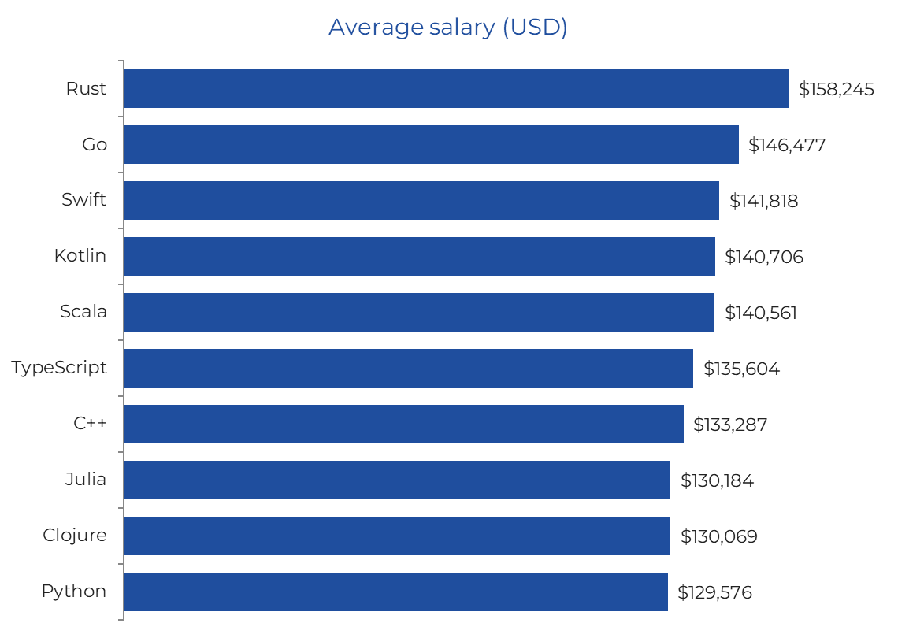

Salary
Top 10 highest-paying languages (average USD)
KEY TAKEAWAYS
  Rust pays the most at ~$158K, ~29% above the ~$123K average
  Go, Swift, Kotlin and Scala follow at ~$141K-$146K
  TypeScript (~$136K) is the best-paid of the top-3 demand languages
  Python sits at ~$130K: strong demand, mid-range pay

Slide 7
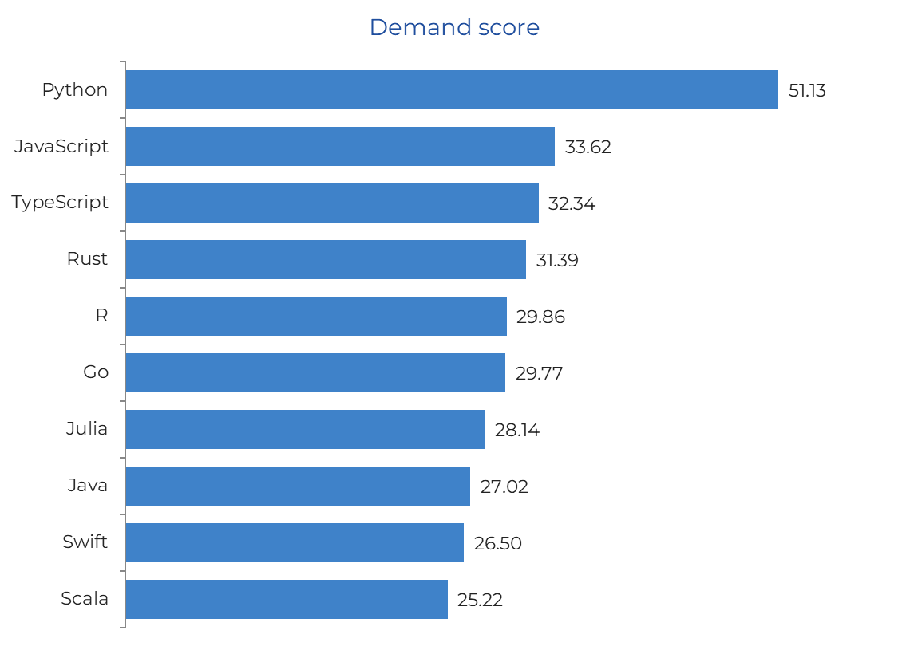
DEMAND
Top 10 languages by demand score
KEY TAKEAWAYS
  Python leads with a score of 51.13, ~50% above JavaScript
  JavaScript and TypeScript form a clear second tier (~32-34)
  Rust, R, Go and Julia are close behind (28-31)
  Average demand across all languages is 22.69

Slide 8
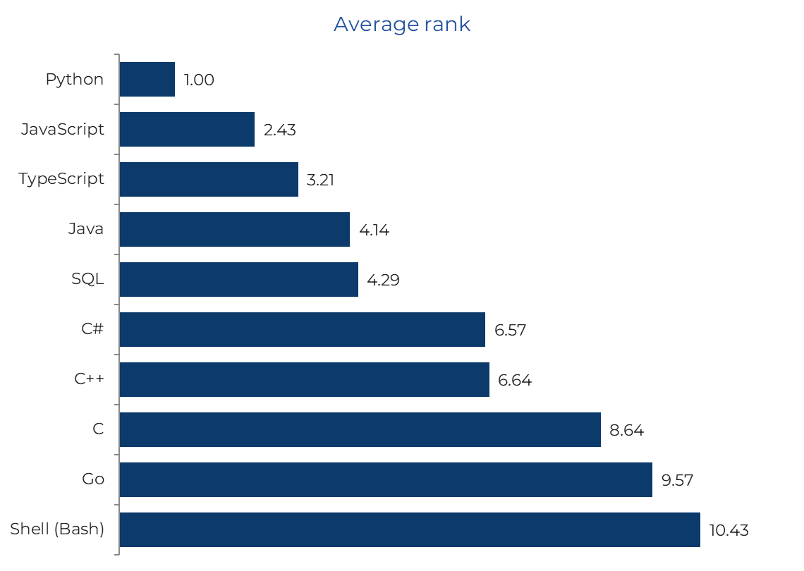
MARKET & POPULARITY
Combined Tiobe & Pypl average rank (lower = more popular)
KEY TAKEAWAYS
  Python is #1 on both Tiobe and Pypl
  Python, JavaScript, TypeScript, Java, SQL hold the top 5 on both lists
  Since 2020, TypeScript has risen while JavaScript has slipped
  GitHub repositories rise with popularity: top languages reach 250K-300K+

Slide 9
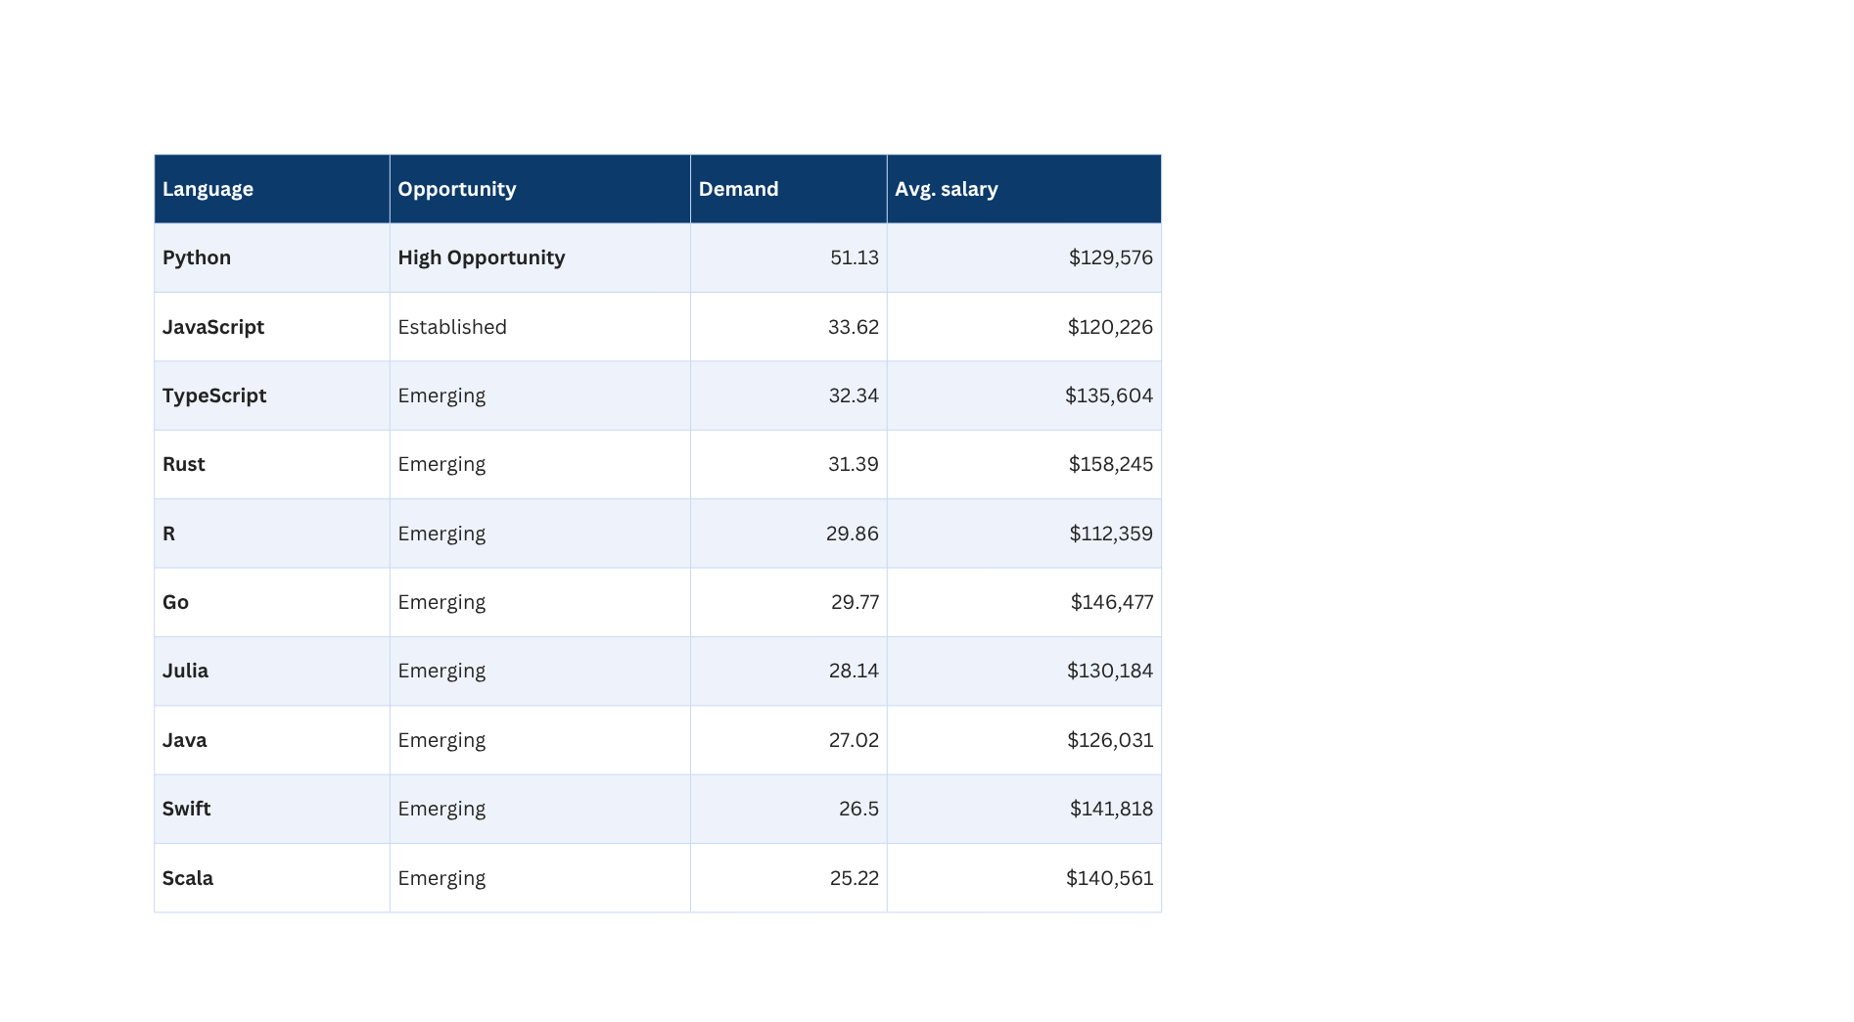
MARKET & POPULARITY
Combined Tiobe & Pypl average rank (lower = more popular)
KEY TAKEAWAYS
  Python is the only "High Opportunity" language and the top opportunity pick
  JavaScript is "Established": high demand, mature market
  8 of the top 10 are "Emerging"
  Demand and salary rise together; learning difficulty barely affects pay

Slide 10
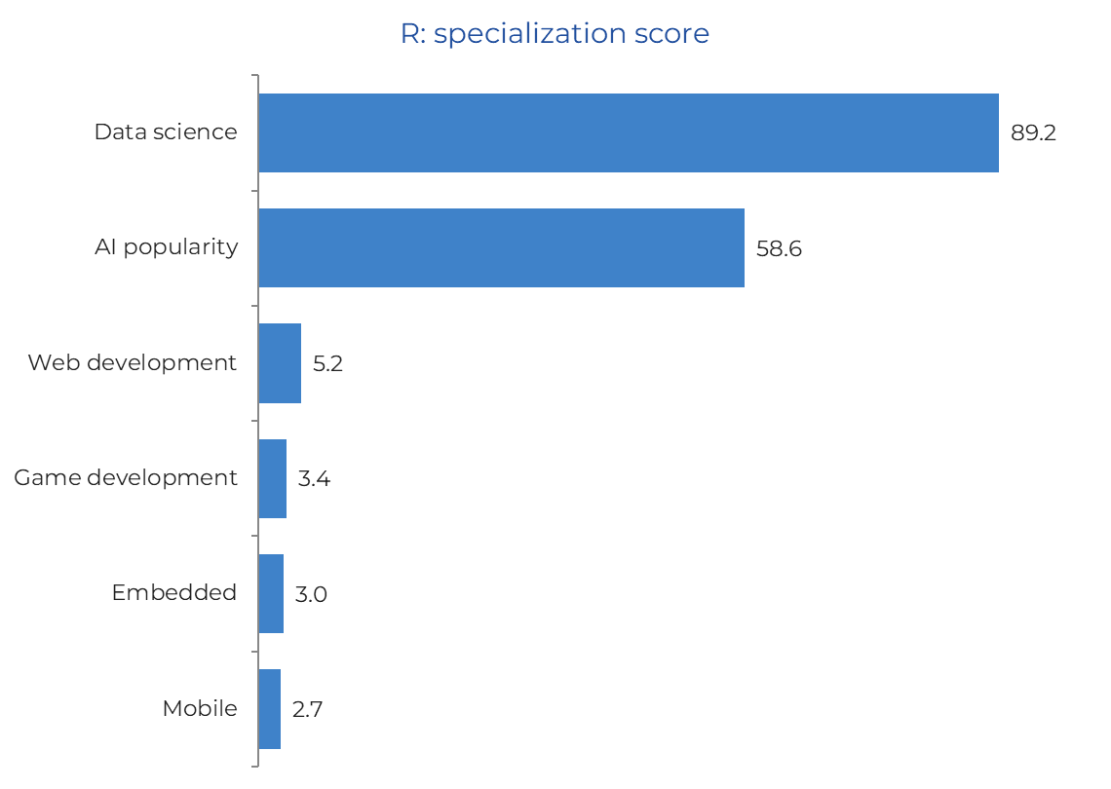
TECHNOLOGY LANDSCAPE
Specialization scores, example: R
KEY TAKEAWAYS
  R scores 89.2 in data science and 58.6 in AI
  Web, game, embedded and mobile all score below 6
  R is a niche, analytics-focused language
  Specialization is a key factor when choosing a language by career goal

Slide 11
TECHNOLOGY LANDSCAPE
Specialization scores, example: R
KEY TAKEAWAYS
  R scores 89.2 in data science and 58.6 in AI
  Web, game, embedded and mobile all score below 6
  R is a niche, analytics-focused language
  Specialization is a key factor when choosing a language by career goal

Slide 12

INSIGHT & RECOMMENDATION
HIGHER-PAY SEEKERS
LEARNERS & JOB SEEKERS
HIRING MANAGERS
Target Rust, Go, Swift or Kotlin. Expect a smaller, more specialized job market.
Start with Python for the broadest demand and pair it with TypeScript for web roles.
Expect competition for Python and TypeScript talent; Rust and Go talent is scarcer and costs more.
DATA & AI ROLES
Use Python, R or Julia. Python has the strongest demand of the three.
CONCLUSION Python is the best all-round choice, Rust maximizes salary, and TypeScript is the language to watch.

Slide 13
Dataset
global-programming-languages-intelligence-dataset

Slide 14
Presented by :
Yasmin Zacarias
Power BI Dashboard

Slide 15
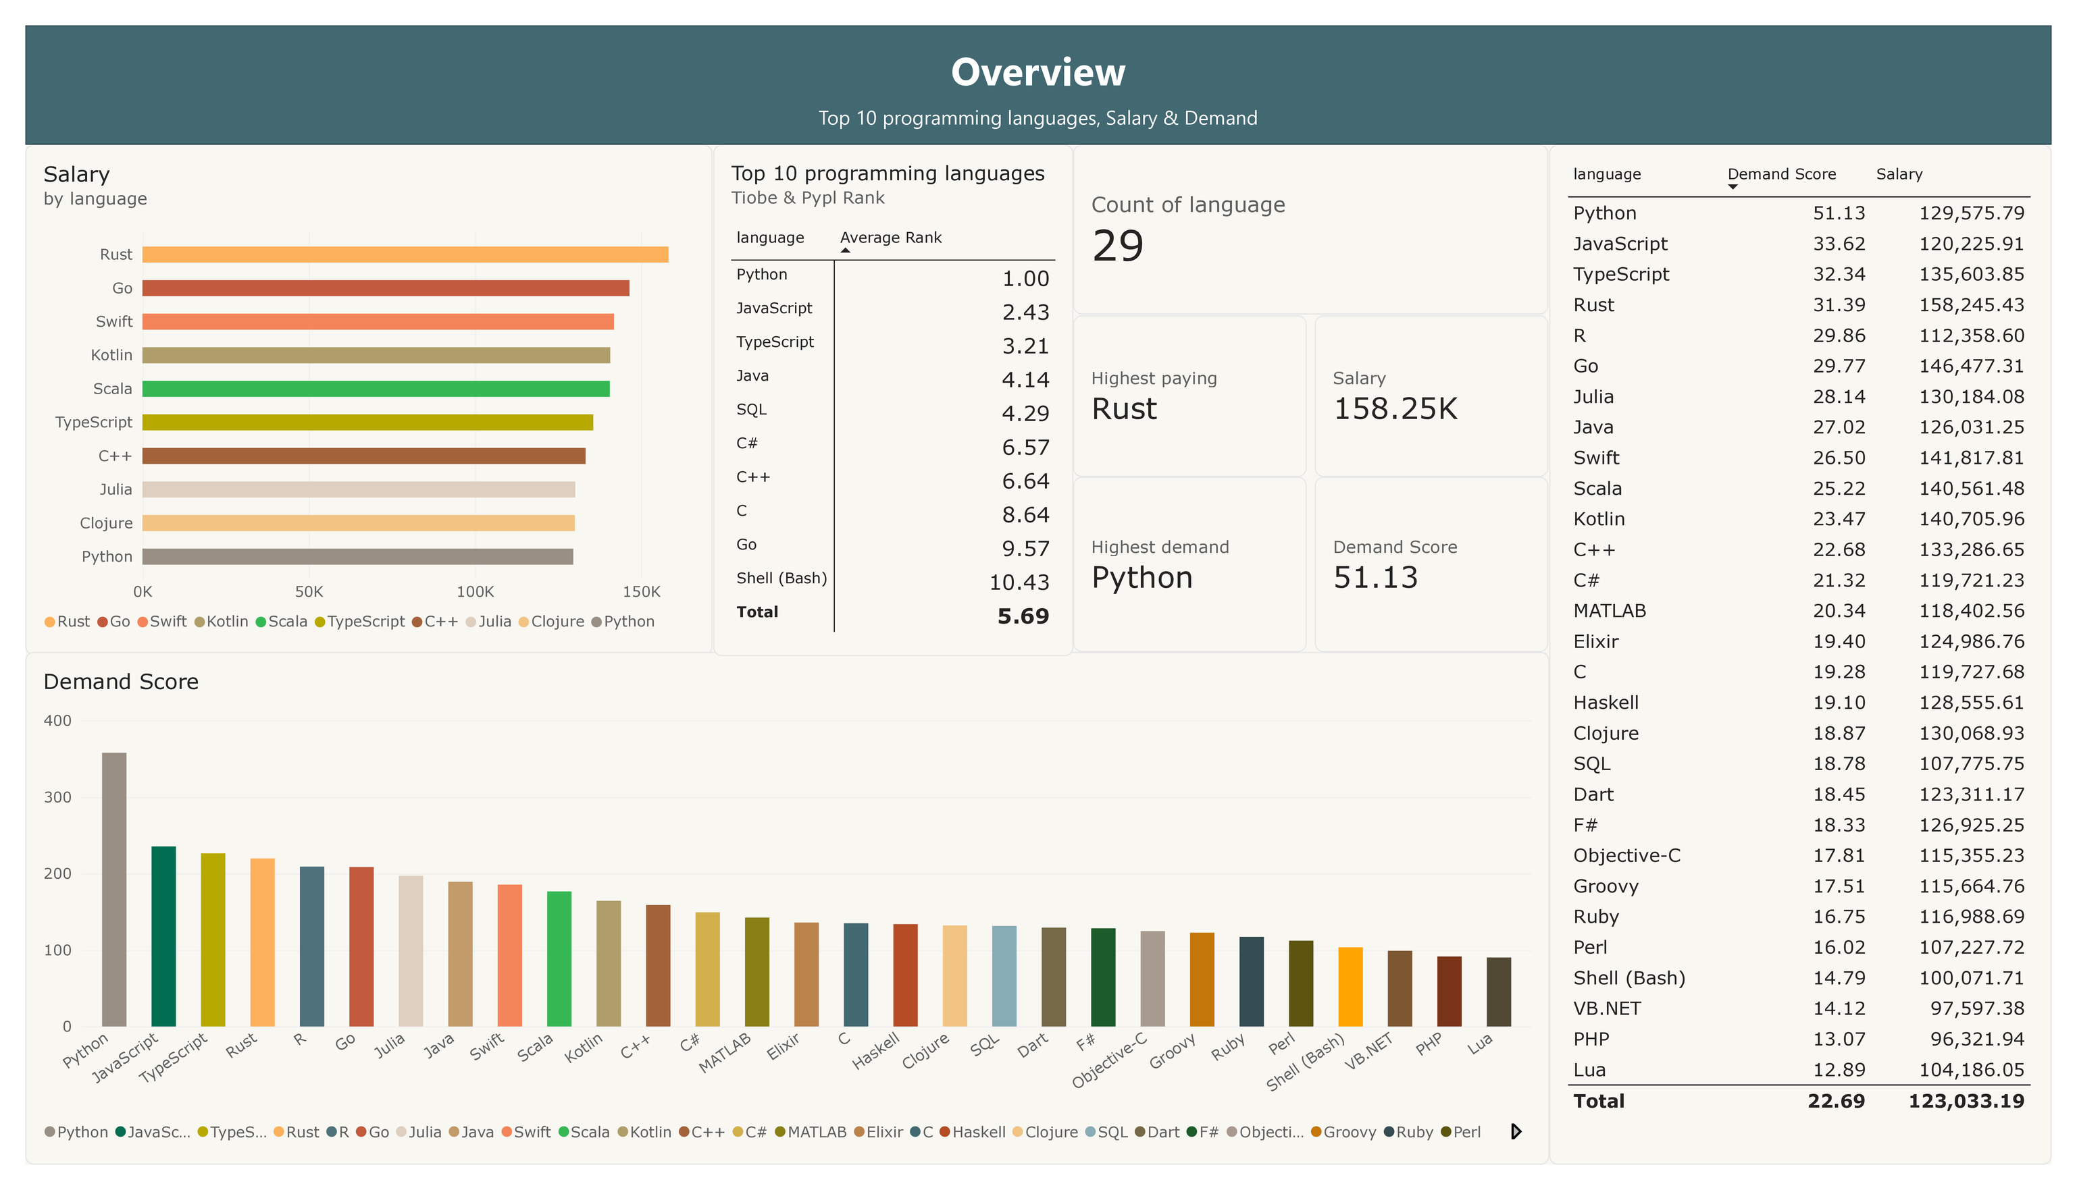

Slide 16
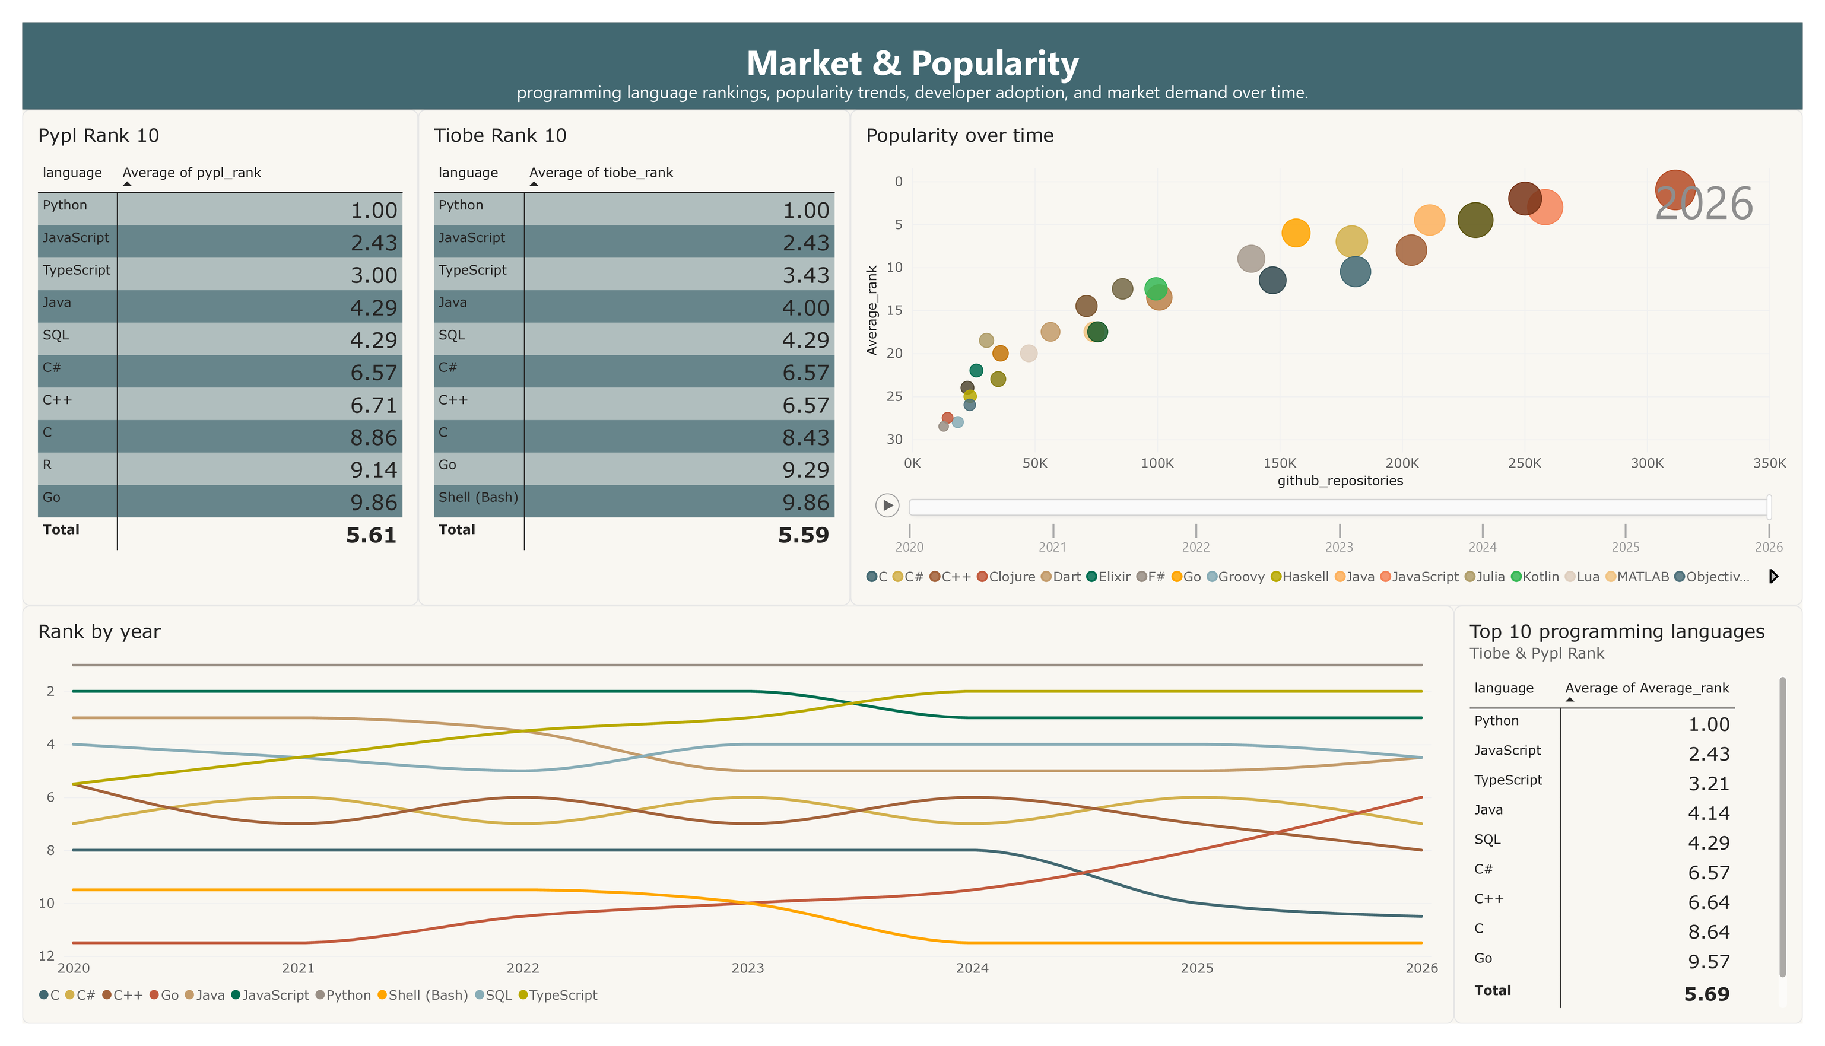

Slide 17
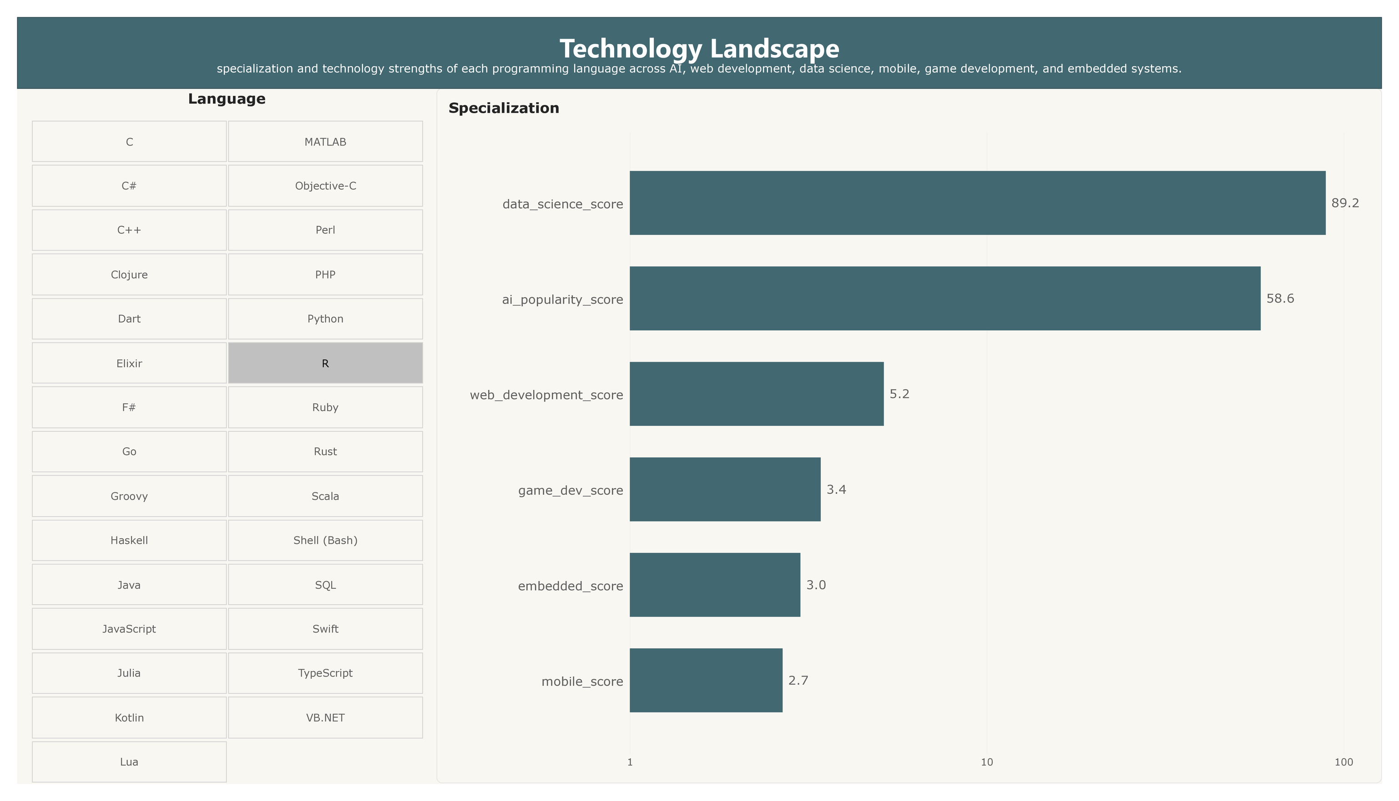

Slide 18
